Slide 1
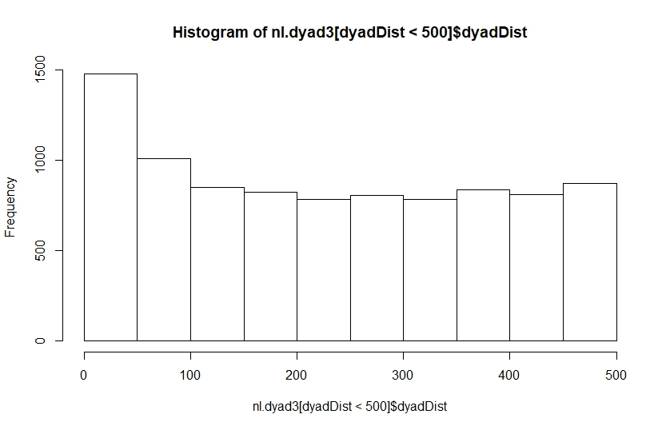
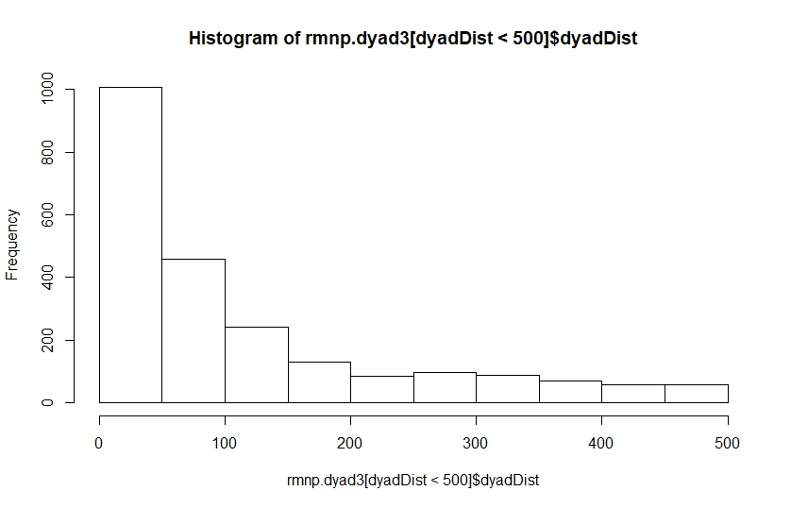
Distribution of dyad distance for NL and RMNP at the 500m threshold.
These two distributions are different.

Slide 2
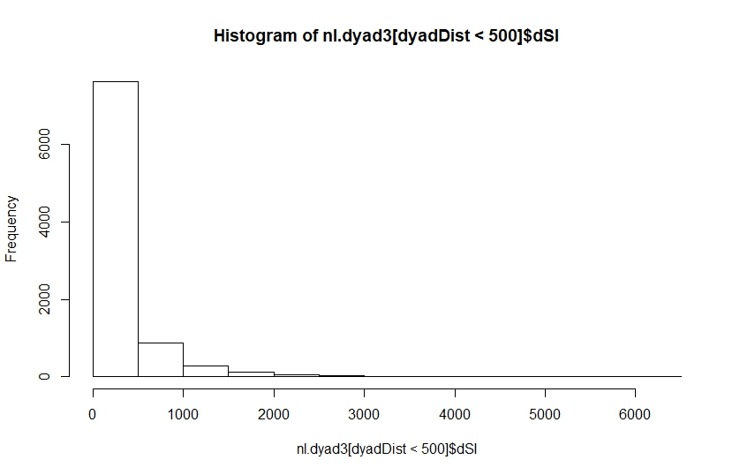
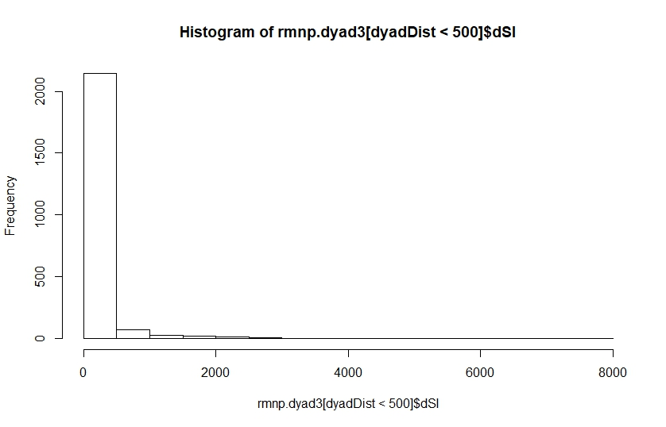
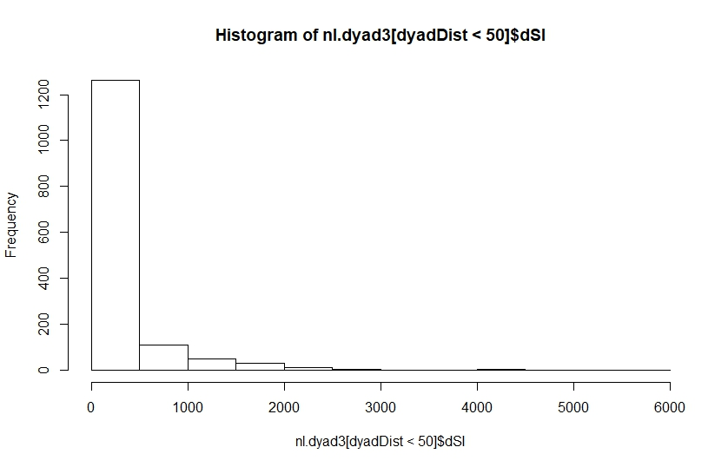
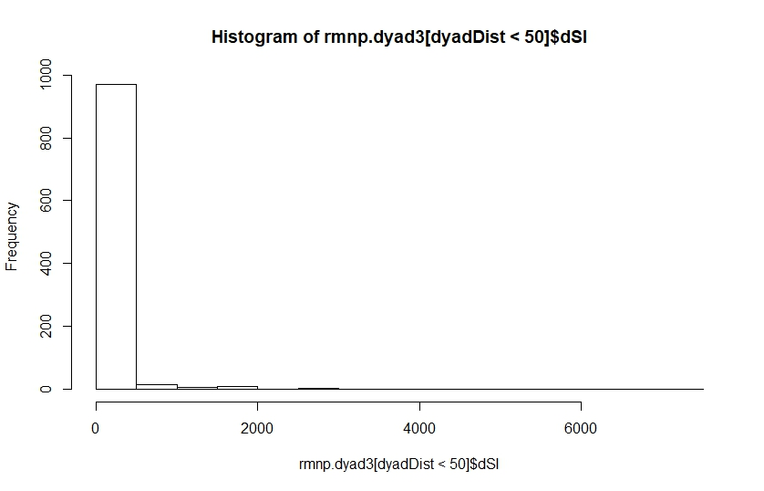
Distribution of difference in step length for NL and RMNP. At both the 500m and 50m thresholds.
These extremely long-tailed distributions are driving the results of the GLMs

Slide 3
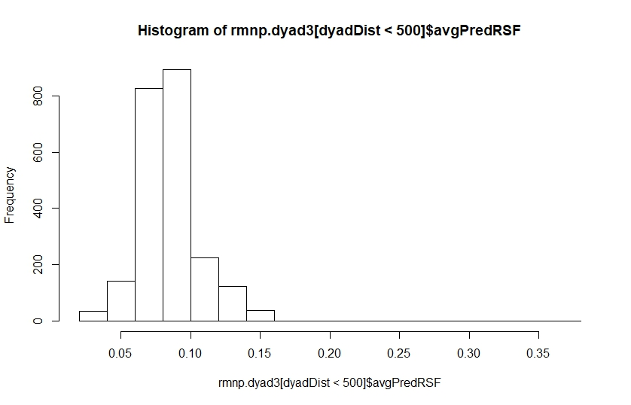
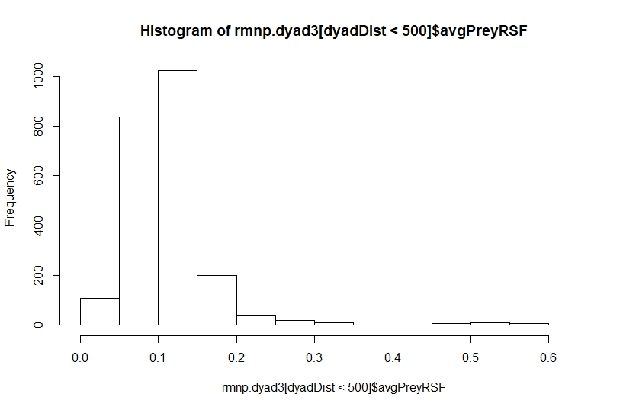
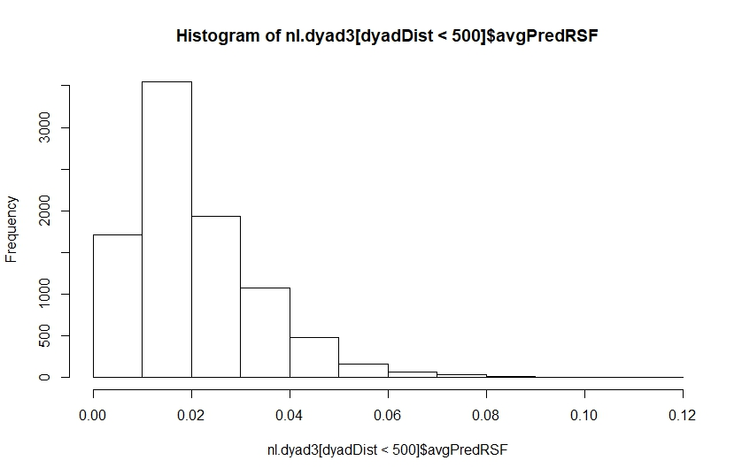
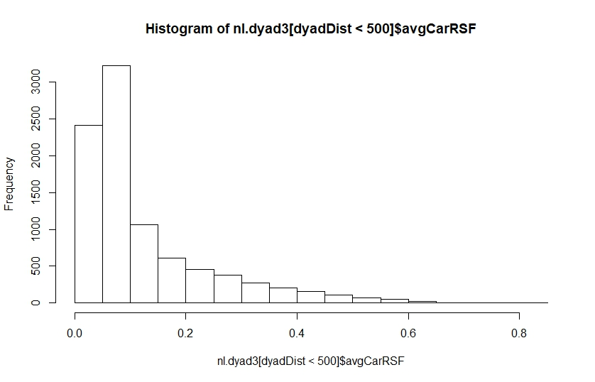
Distributions of predator and prey RSFs for RMNP and NL at the 500m threshold.
Notice the scale of the RSFs values between predator and prey are roughly equivalent for RMNP but not for NL

Slide 4
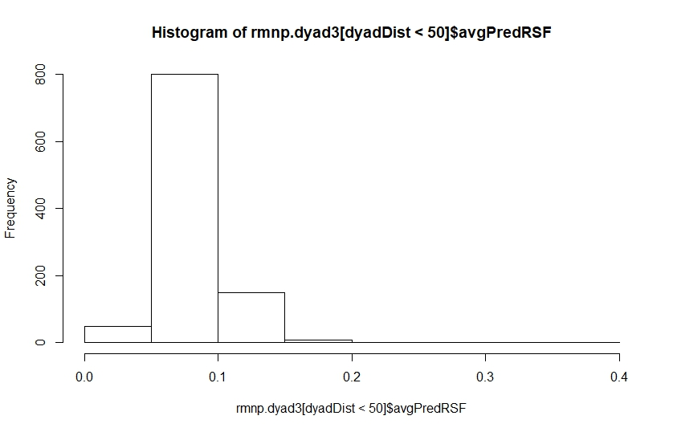
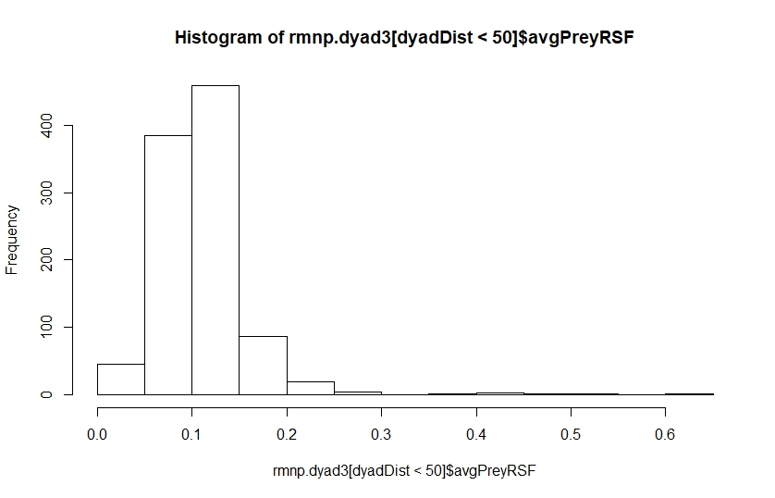
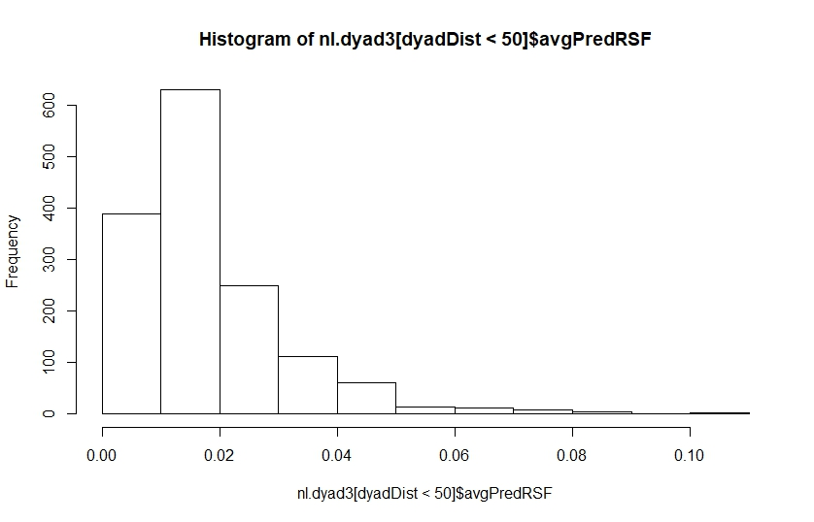
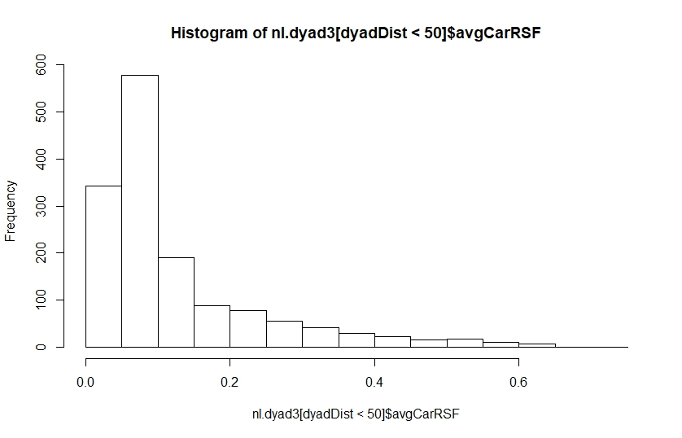
Distributions of predator and prey RSFs for RMNP and NL at the 50m threshold.
Notice the scale of the RSFs values between predator and prey are roughly equivalent for RMNP but not for NL.
So the pattern (or problem?) persists at the 50m threshold.

